Slide 1
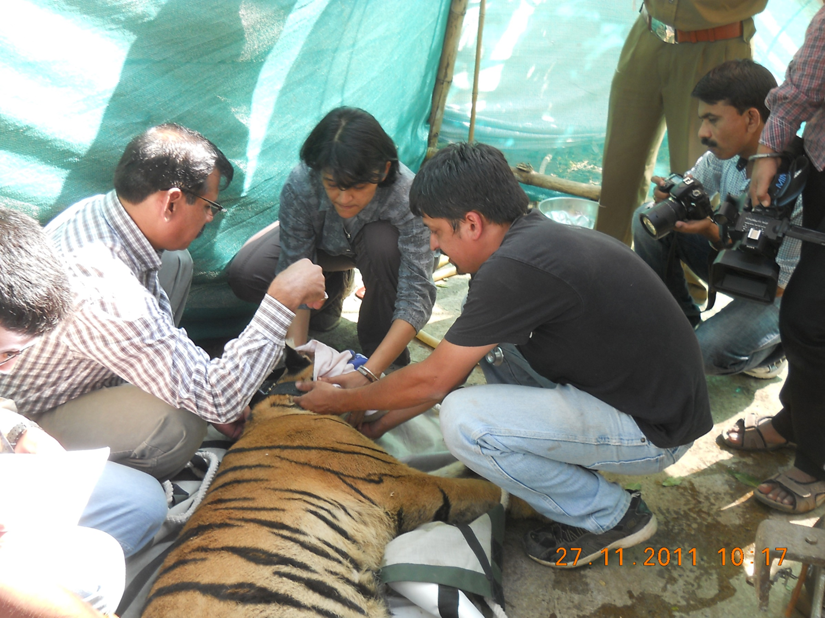
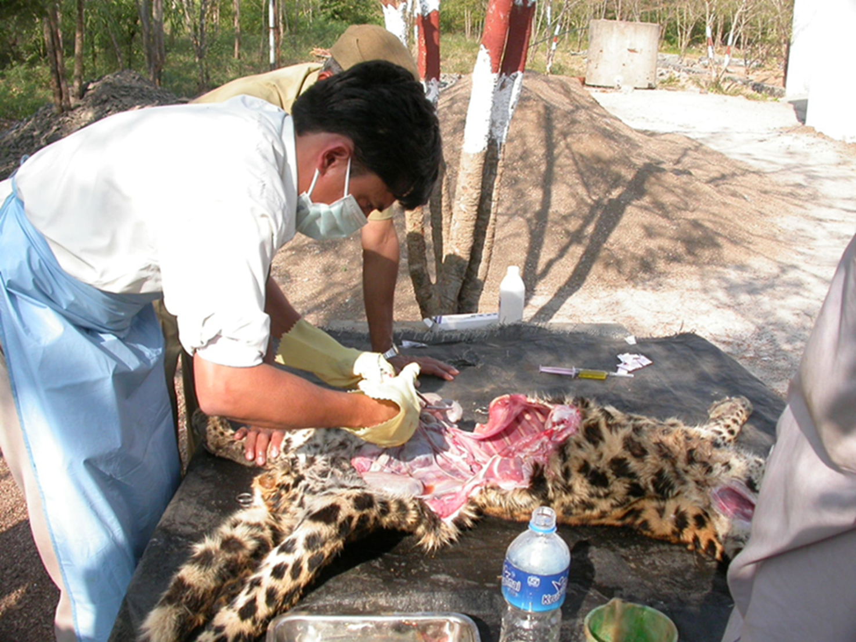
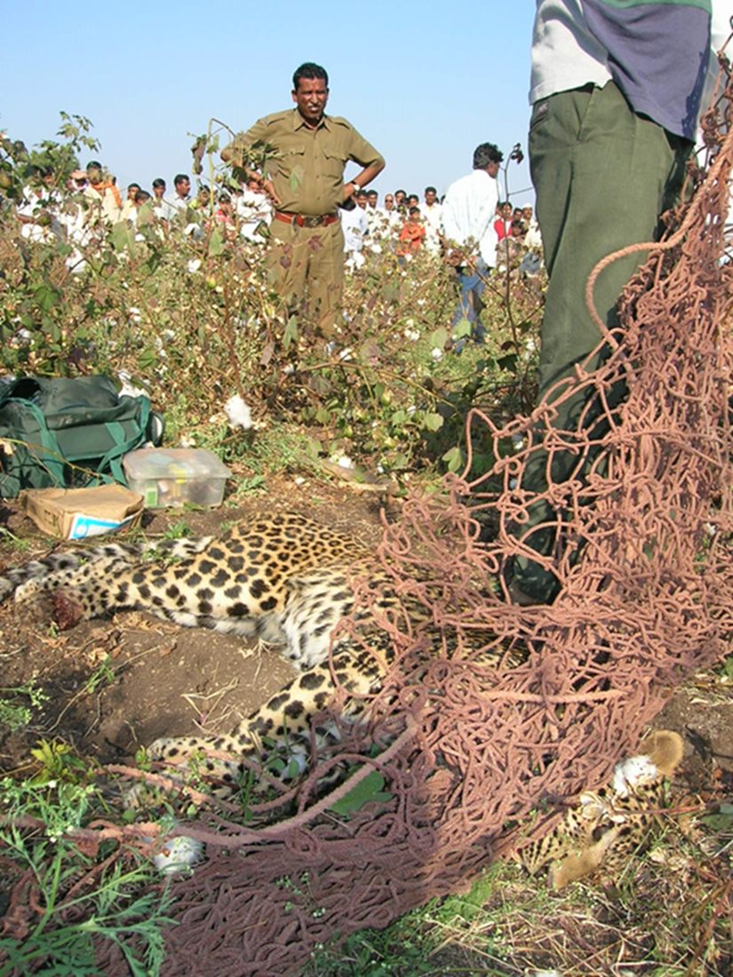
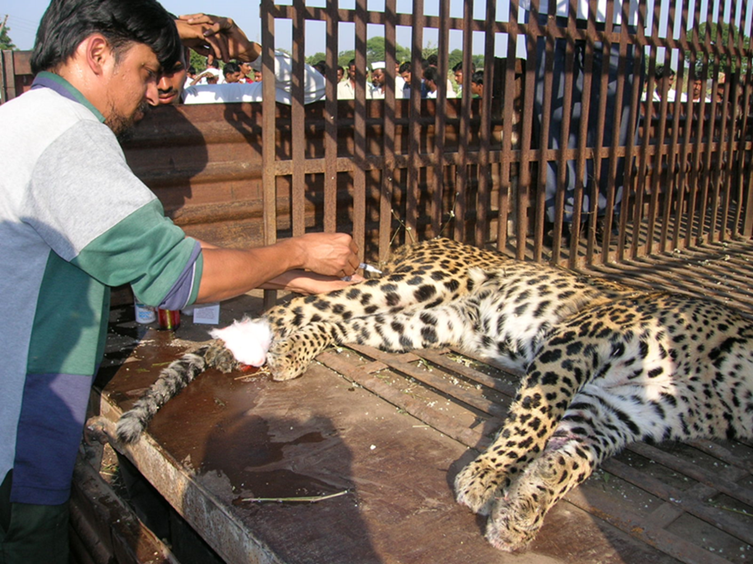

Slide 2

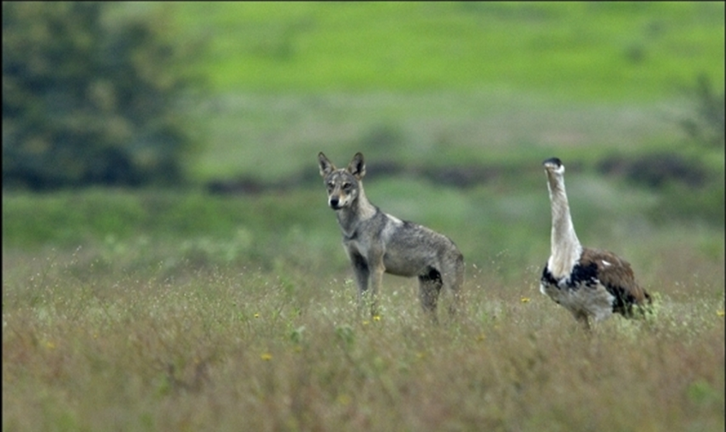
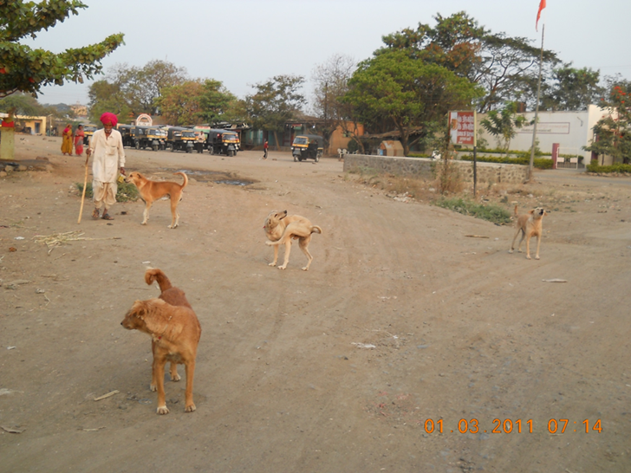

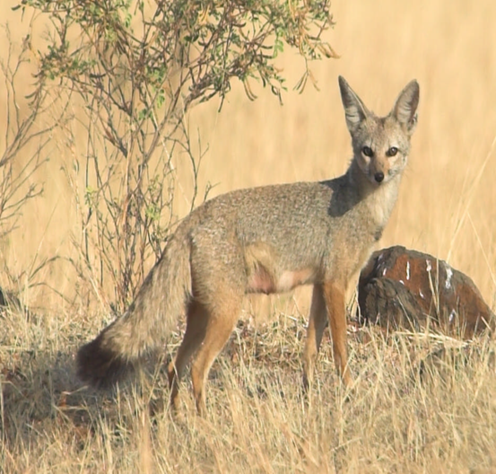
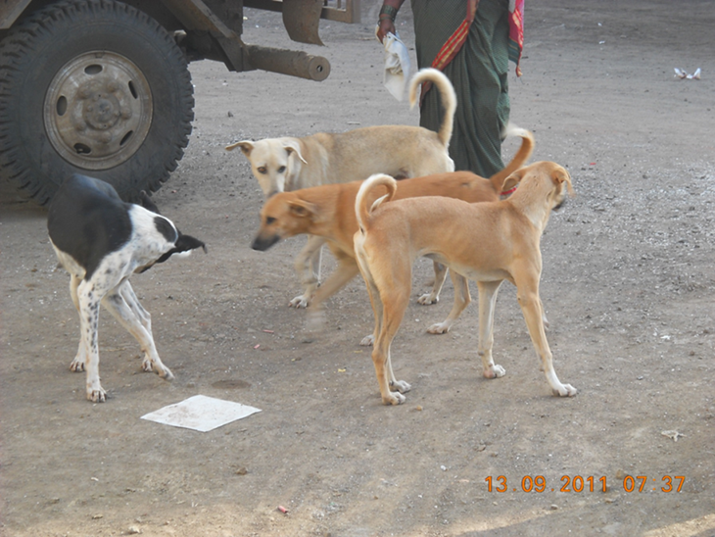
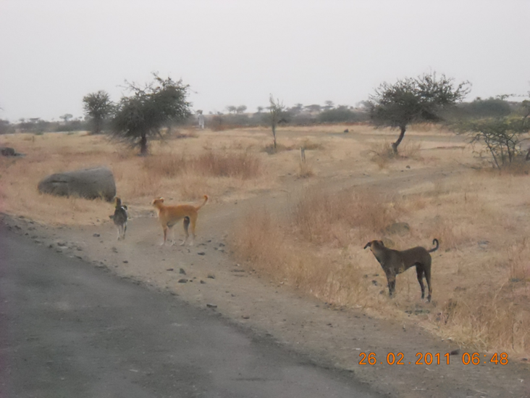
Notes:
Behavior, health parameters, ecology differ markedly between categories
Human-dog interaction

Slide 3
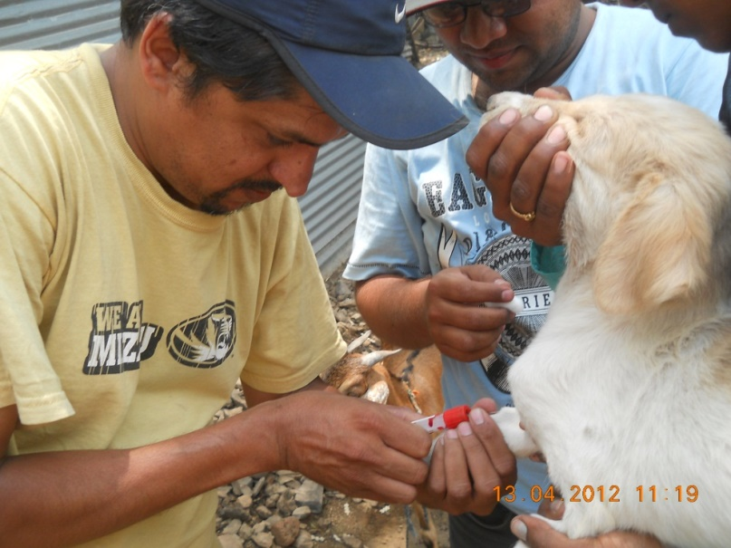
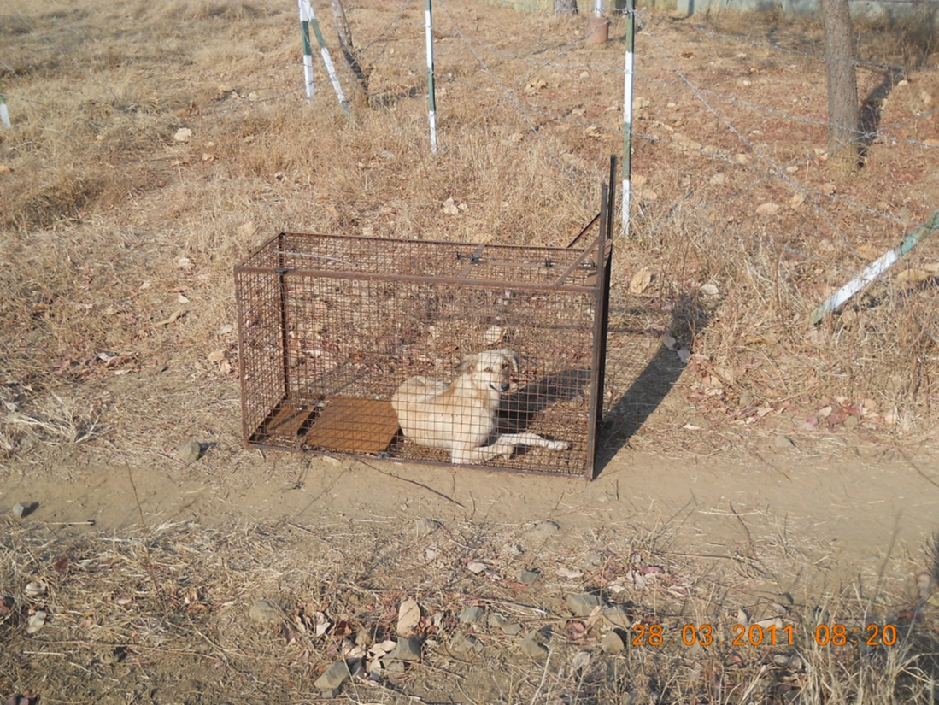
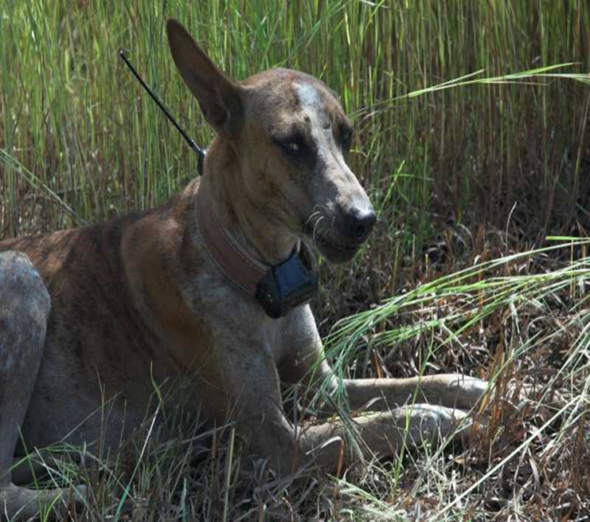
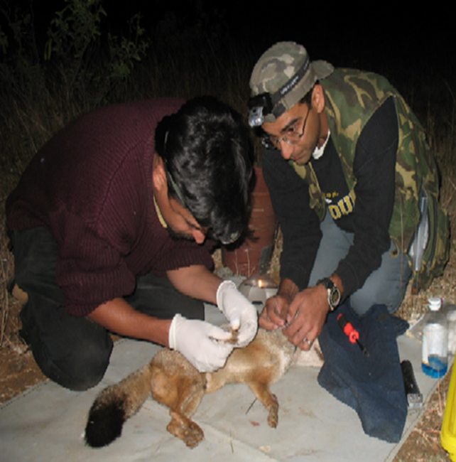
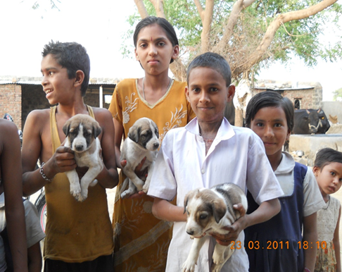
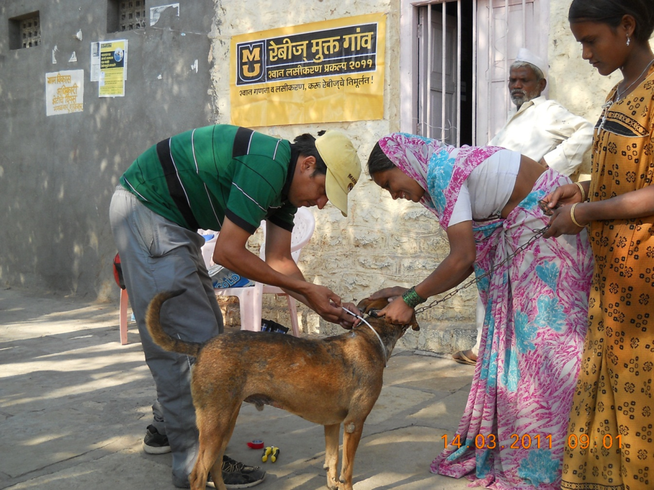
Notes:
Being a veterinarian, I decided to make use of this opportunity to undertake a demographic and epidemiologic assessment of the dog populations.
Mass vaccination campaigns provided an opportunity for demographic and epidemiologic assessment of dog populations. By using the assistance of putative owners/reference persons, and in some cases using box traps, dogs were handled on several occasions between 2011 and 2013 (~700 individuals handled on ~1200 occasions) without a single instance of dog bite (to the handlers or onlookers) and no injury to the dog.

Slide 4

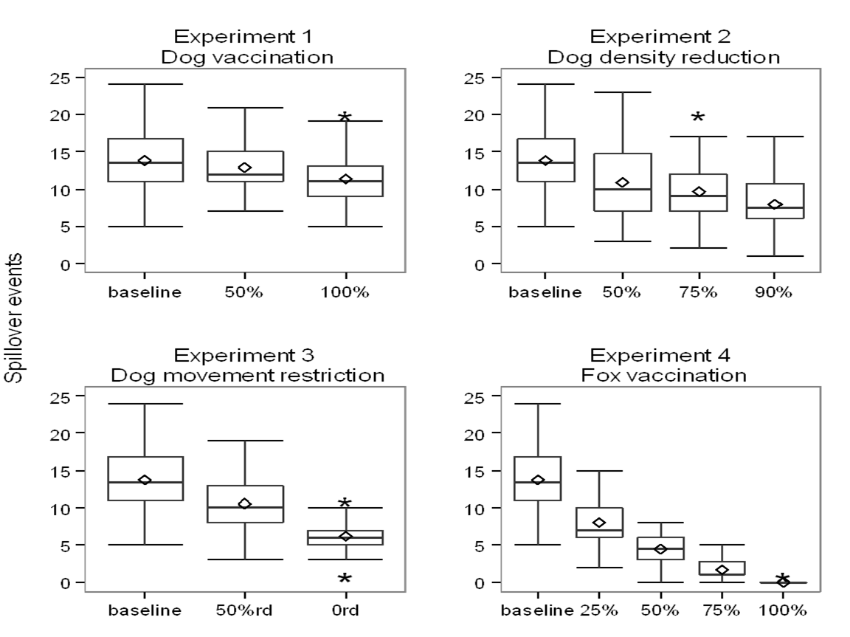


Slide 5
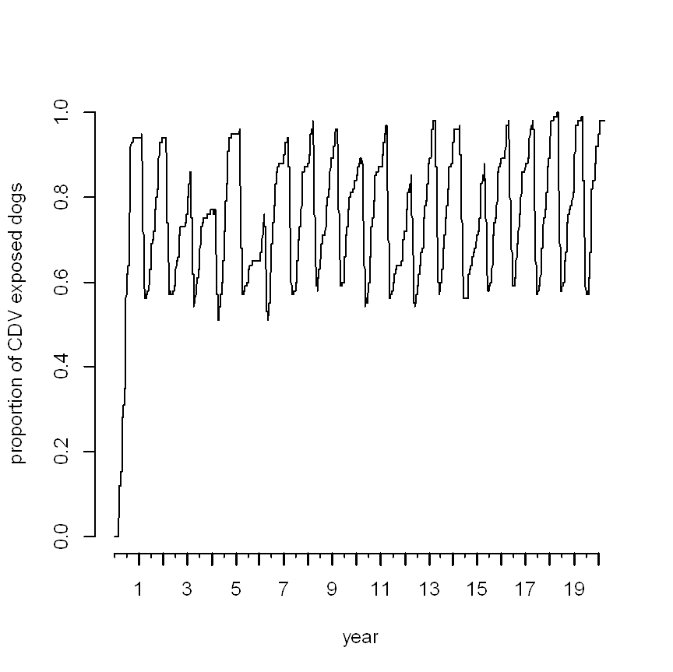
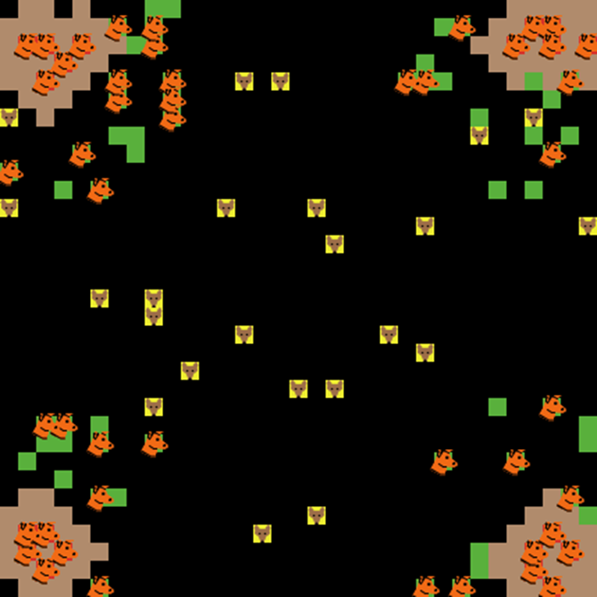
Belsare, A.V., Gompper, M.E., 2015. A model-based approach for investigation and mitigation of disease spillover risks to wildlife: Dogs, foxes and canine distemper in central India. Ecological Modelling 296, 102-112.
Notes:
coding using NetLogo and R, PARAMETERIZED WITH FIELD DATA
The basic reproductive number (R0) for CDV in the model fox population was 0.85, indicating that CDV could not be independently sustained in the fox population.
The model was then used to compare and contrast potential management strategies to mitigate CDV spillover risks.
Vaccination of local dog populations was an ineffective disease control strategy, while fox vaccination was highly effective.
Interventions potentially resulting in lower contact rates between dogs and foxes, like reduction in village dog density and restricting dog movements in fox habitat, implemented in a sustained and integrated manner would be most effective in mitigating disease threats to foxes.
Integrating Ecology, Epidemiology and Model Explorations to Address Disease Threats

Slide 6
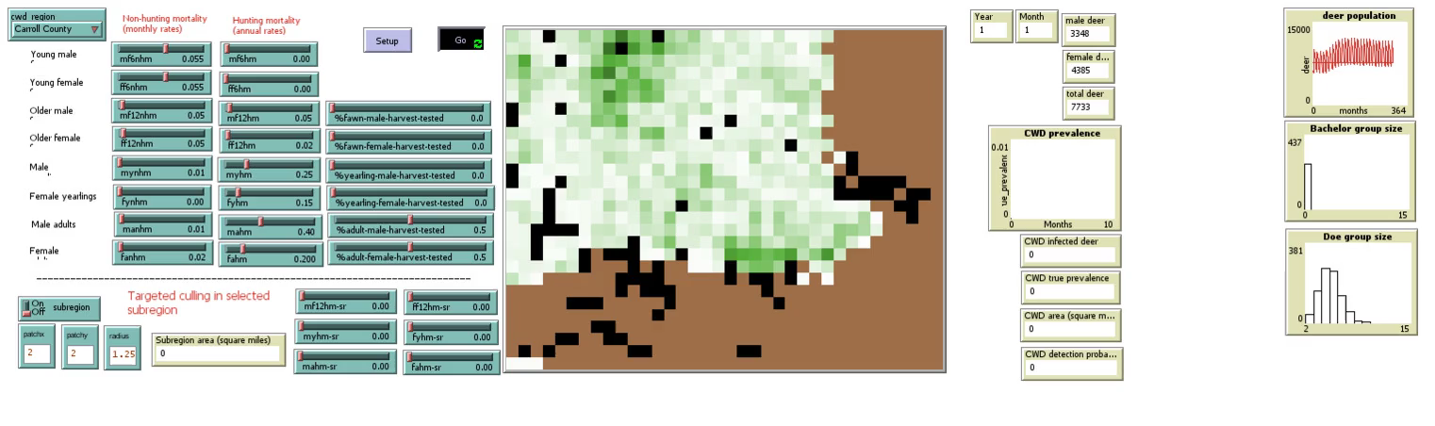

Slide 7
develop a quantitative framework to better understand how human behavior affects the risk and transmission of zoonotic diseases in human communities.
to develop a quantitative framework of human infectious disease dynamics that incorporates the interplay of ecology, epidemiology, health infrastructure, and a nuanced view of human behavior that is empirically based and allows for heterogeneity in social influence and response to risk.
Notes:
public health policies are often biased-grossly overestimate their ability to control behavior via making recommendations or setting policy. The long-term goal of this research is to develop a quantitative framework of human infectious disease dynamics that incorporates the interplay of ecology, epidemiology, health infrastructure, and a nuanced view of human behavior that is empirically based and allows for heterogeneity in social influence and response to risk.
To better understand transmission dynamics and the likelihood of zoonotic spillover, it is vital to adopt a comprehensive approach that integrates interactions between pathogens, their human and non-human hosts, vectors, and ecosystems. In these systems, human behavior plays a major role in influencing disease dynamics and therefore the risk of contracting the disease.
Humans are complex and heterogenous. Some may promptly adopt preventive behavior (for example, preventive vaccination), while others may respond to perceived risk dependent on their own personality, experiences, and inter-personal influence from others. Some people will follow recommendations, some will reject, while many people are flexible and their behavior depends on ideology, social influence, economics, and perceived risk and benefit

